Slide 1
Introduction to CPU
The part of the computer that performs the bulk of data processing operation is called central processing unit.
The CPU is made up of three major parts:
The register set stores intermediate data used during the execution of instruction.
The ALU performs the required the micro operation for the executing the instruction.
The control unit supervise the transfer of information of information among the register and instruct the ALU as which operation to perform

Slide 2
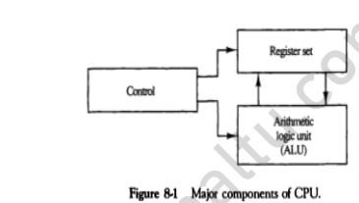

Slide 3
General Register organization
Generally CPU has seven general registers.
Register organization show how registers are selected and how data flow between register and ALU.
A decoder is used to select a particular register.
The output of each register is connected to two multiplexers to form the two buses A and B.
The selection lines in each multiplexer select the input data for the particular bus.
The A and B buses form the two inputs of an ALU.
The operation select lines decide the micro operation to be performed by ALU.
The result of the micro operation is available at the output bus.
The output bus connected to the inputs of all registers, thus by selecting a destination register it is possible to store the result in it.

Slide 4
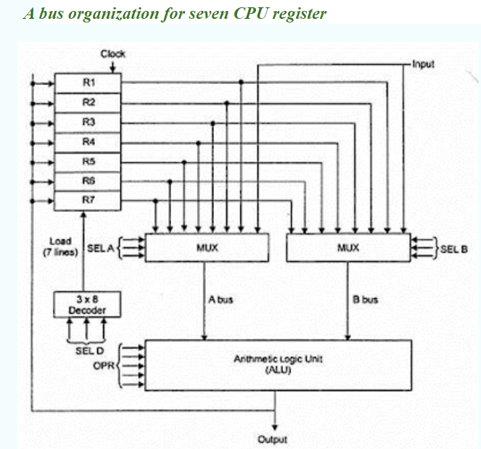

Slide 5
Operation of control unit
The control unit directs the information flow through ALU by :
Selecting various components in the system .
Selecting the function of ALU.

Slide 6
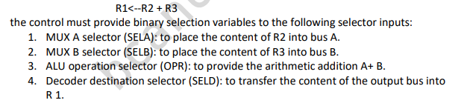
Examples

Slide 7
CONTROL WORD
The combined value of a binary selection inputs specifies the control word.
• It consist of four fields SELA,SELB,and SELD or SELREG contains three bit each and SELOPR field contains four bits thus the total bits in the control word are 13-bits.

Slide 8
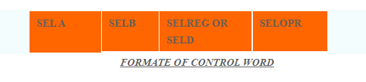

Slide 9
The three bit of SELA select a source registers of the a input of the ALU.
The three bits of SELB select a source registers of the b input of the ALU.
The three bits of SELED or SELREG select a destination register using the decoder.
The four bits of SELOPR select the operation to be performed by ALU.

Slide 10
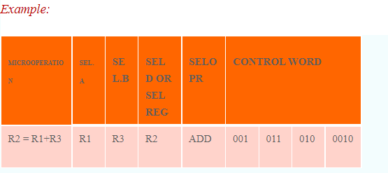

Slide 11
Stack organization
Stack is also known as the Last In First Out (LIFO) list. I
t is the most important feature in the CPU.
It saves data such that the element stored last is retrieved first.
A stack is a memory unit with an address register. T
his register influence the address for the stack, which is known as Stack Pointer (SP).
The stack pointer continually influences the address of the element that is located at the top of the stack.
It can insert an element into or delete an element from the stack. The insertion operation is known as push operation and the deletion operation is known as pop operation.
In a computer stack, these operations are simulated by incrementing or decrementing the SP register.

Slide 12
Register Stack
The stack can be arranged as a set of memory words or registers. Consider a 64-word register stack arranged as displayed in the figure. The stack pointer register includes a binary number, which is the address of the element present at the top of the stack. The three-element A, B, and C are located in the stack.
The element C is at the top of the stack and the stack pointer holds the address of C that is 3. The top element is popped from the stack through reading memory word at address 3 and decrementing the stack pointer by 1. Then, B is at the top of the stack and the SP holds the address of B that is 2. It can insert a new word, the stack is pushed by incrementing the stack pointer by 1 and inserting a word in that incremented location.

Slide 13
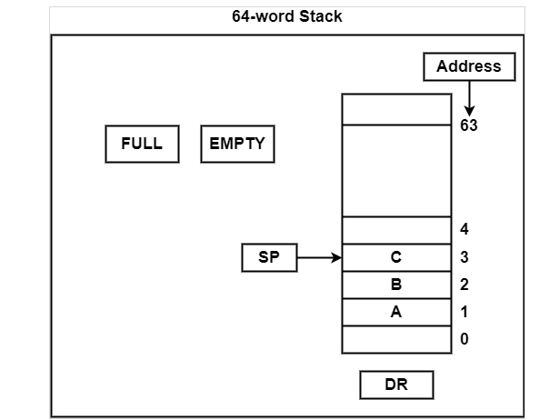

Slide 14
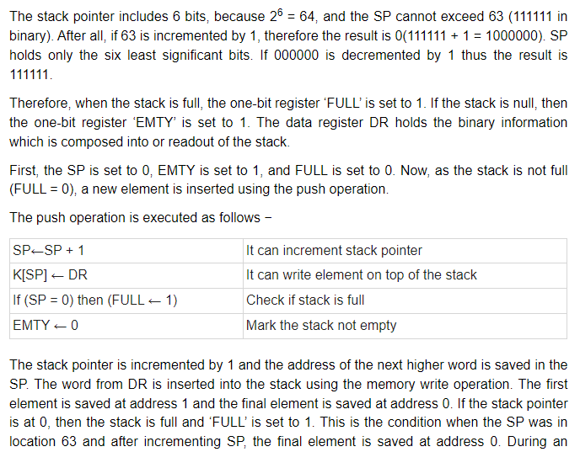

Slide 15
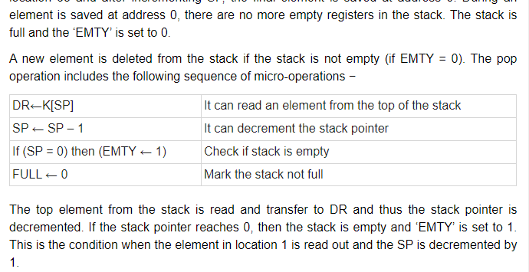

Slide 16
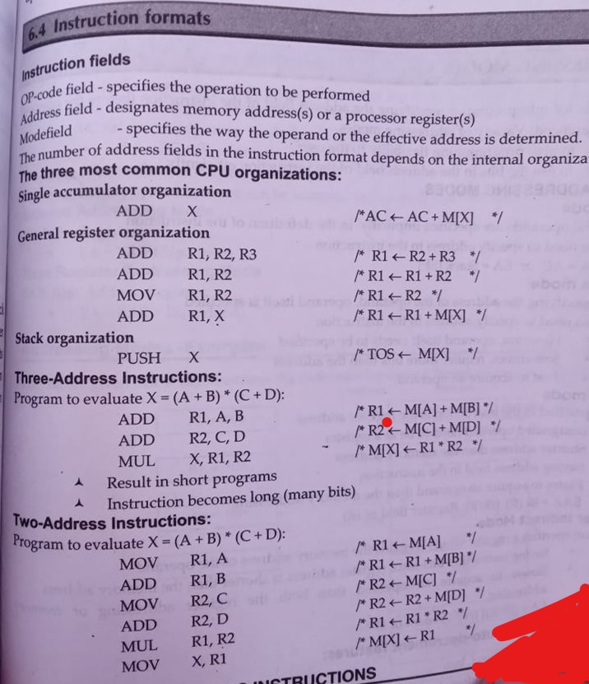
Instruction Formt

Slide 17
Addressing modes
Specifies a rules for interperting or modifying the address field of the insruction.
The purpose of using addressing modes is as follows:
To give the programming versatility to the user.
To reduce the number of bits in addressing field of instruction.

Slide 18
Types of Addressing Modes
Immediate Mode
In this mode, the operand is specified in the instruction itself. An immediate mode instruction has an operand field rather than the address field.

Slide 19
Register Mode
In this mode the operand is stored in the register and this register is present in CPU.
The instruction has the address of the Register where the operand is stored.

Slide 20
Register Indirect Mode
In this mode, the instruction specifies the register whose contents give us the address of operand which is in memory. Thus, the register contains the address of operand rather than the operand itself.

Slide 21
Auto Increment/Decrement Mode
In this the register is incremented or decremented after or before its value is used.

Slide 22
Direct Addressing Mode
In this mode, effective address of operand is present in instruction itself.
Single memory reference to access data.
No additional calculations to find the effective address of the operand.

Slide 23
Indirect Addressing Mode
In this, the address field of instruction gives the address where the effective address is stored in memory. This slows down the execution, as this includes multiple memory lookups to find the operand.

Slide 24
Relative Addressing Mode
It is a version of Displacement addressing mode.
In this the contents of PC(Program Counter) is added to address part of instruction to obtain the effective address.

Slide 25
Base Register Addressing Mode
It is again a version of Displacement addressing mode. This can be defined as EA = A + (R), where A is displacement and R holds pointer to base address.

Slide 26
Types of interrupt
Generally there are three types o Interrupts those are Occurred For Example
1) Internal Interrupt 2) Software Interrupt. 3) External Interrupt.
The External Interrupt occurs when any Input and Output Device request for any Operation and the CPU will Execute that instructions first
For Example When a Program is executed and when we move the Mouse on the Screen then the CPU will handle this External interrupt first and after that he will resume with his Operation.
The Internal Interrupts are those which are occurred due to Some Problem in the Execution For Example When a user performing any Operation which contains any Error and which contains any type of Error. So that Internal Interrupts are those which are occurred by the Some Operations or by Some Instructions and the Operations those are not Possible but a user is trying for that Operation. And
The Software Interrupts are those which are made some call to the System for Example while we are Processing Some Instructions and when we wants to Execute one more Application Programs.

Slide 27
Data transfer instruction
Moves data from one place in a computer to another without changing the data content.
The most common transfer date between memory and processor & between processor register and input output device.

Slide 28
The data manipulation instructions in a typical computer usually divided into three basic types as follows.
Arithmetic instructions
Logical and bit manipulation instructions
Shift instructions

Slide 29
Arithmetic instructions
Name | Mnemonic | Example | Explanation
Increment | INC | INC B | It will increment the register B by 1 B<-B+1
Decrement | DEC | DEC B | It will decrement the register B by 1 B<-B-1
Add | ADD | ADD B | It will add contents of register B to the contents of the accumulator and store the result in the accumulator AC<-AC+B
Subtract | SUB | SUB B | It will subtract the contents of register B from the contents of the accumulator and store the result in the accumulator AC<-AC-B
Multiply | MUL | MUL B | It will multiply the contents of register B with the contents of the accumulator and store the result in the accumulator AC<-AC*B
Divide | DIV | DIV B | It will divide the contents of register B with the contents of the accumulator and store the quotient in the accumulator AC<-AC/B
Add with carry | ADDC | ADDC B | It will add the contents of register B and the carry flag with the contents of the accumulator and store the result in the accumulator AC<-AC+B+Carry flag
Subtract with borrow | SUBB | SUBB B | It will subtract the contents of register B and the carry flag from the contents of the accumulator and store the result in the accumulator AC<-AC-B-Carry flag
Negate(2’s complement) | NEG | NEG B | It will negate a value by finding 2’s complement of its single operand. This means simply operand by -1. B<-B’+1

Slide 30
Logical and Bit Manipulation Instructions
Logical instructions perform binary operations on strings of bits stored in registers.
They are useful for manipulating individual bits or a group of bits.

Slide 31
Clear | CLR | CLR | It will set the accumulator to 0 AC<-0
Complement | COM | COM A | It will complement the accumulator AC<-(AC)’
AND | AND | AND B | It will AND the contents of register B with the contents of accumulator and store it in the accumulator AC<-AC AND B
OR | OR | OR B | It will OR the contents of register B with the contents of accumulator and store it in the accumulator AC<-AC OR B
Exclusive-OR | XOR | XOR B | It will XOR the contents of register B with the contents of the accumulator and store it in the accumulator AC<-AC XOR B
Clear carry | CLRC | CLRC | It will set the carry flag to 0 Carry flag<-0
Set carry | SETC | SETC | It will set the carry flag to 1 Carry flag<-1
Complement carry | COMC | COMC | It will complement the carry flag Carry flag<- (Carry flag)’
Enable interrupt | EI | EI | It will enable the interrupt
Disable interrupt

Slide 32
Shift Instructions
Shifts are operations in which the bits of a word are moved to the left or right.
Shift instructions may specify either logical shifts, arithmetic shifts, or rotate-type operations.

Slide 33
Name | Mnemonic
Logical shift right | SHR
Logical shift left | SHL
Arithmetic shift right | SHRA
Arithmetic shift left | SHLA
Rotate right | ROR
Rotate left | ROL
Rotate right through carry | RORC
Rotate left through carry | ROLC

Slide 34
Program control
A program control type of instruction ,when executed may change the address value in the program counter and cause the flow of control to be altered.
The change in value of the program counter as a result of the execution of a program control instruction cause a break in the sequence of instruction execution.

Slide 35
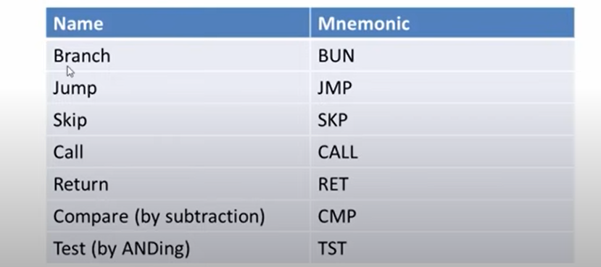

Slide 36
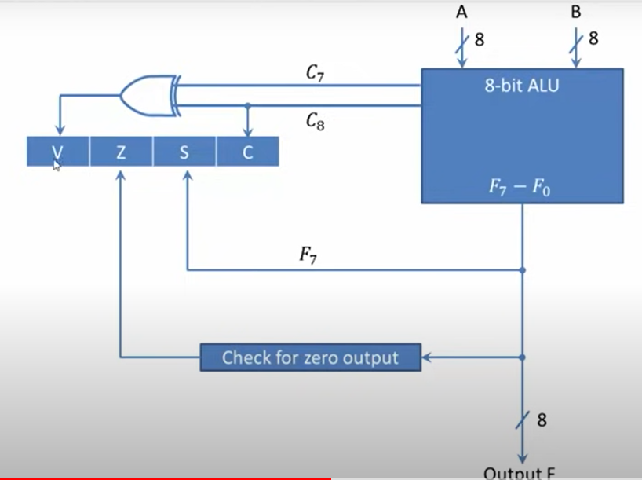

Slide 37
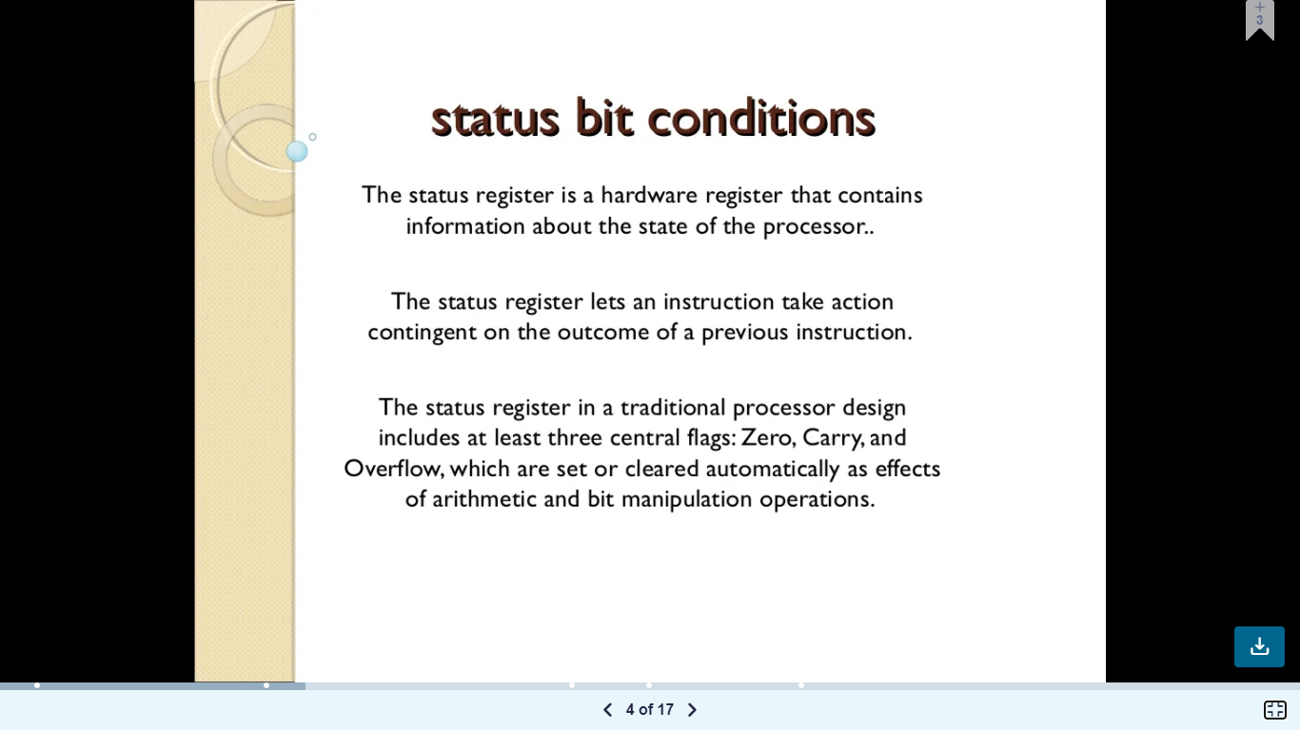

Slide 38
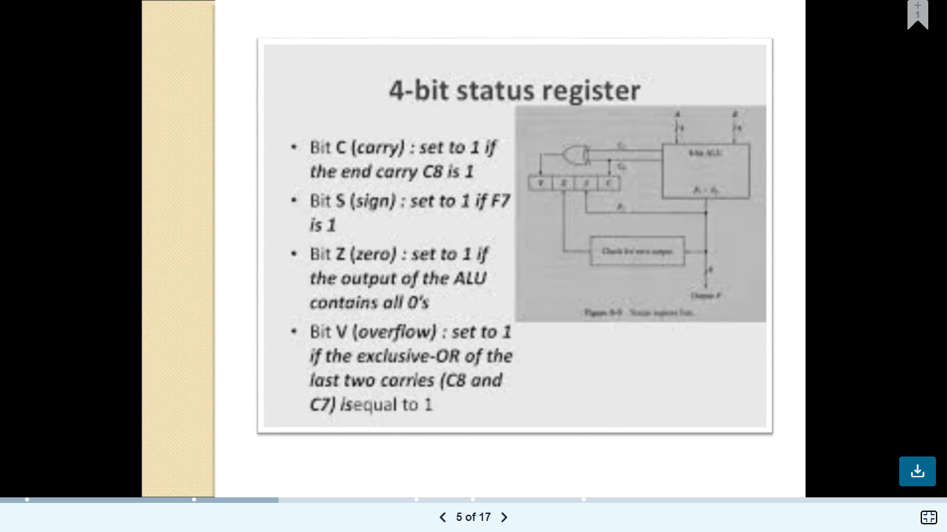

Slide 39
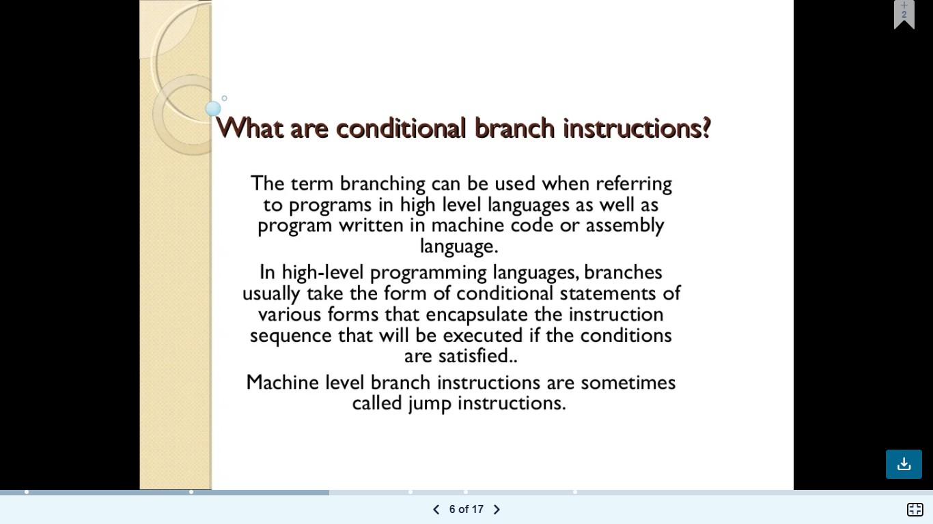

Slide 40
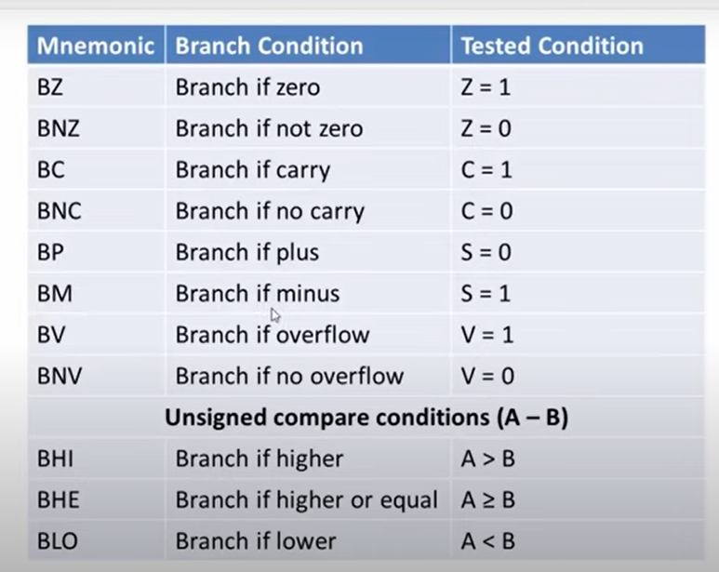

Slide 41
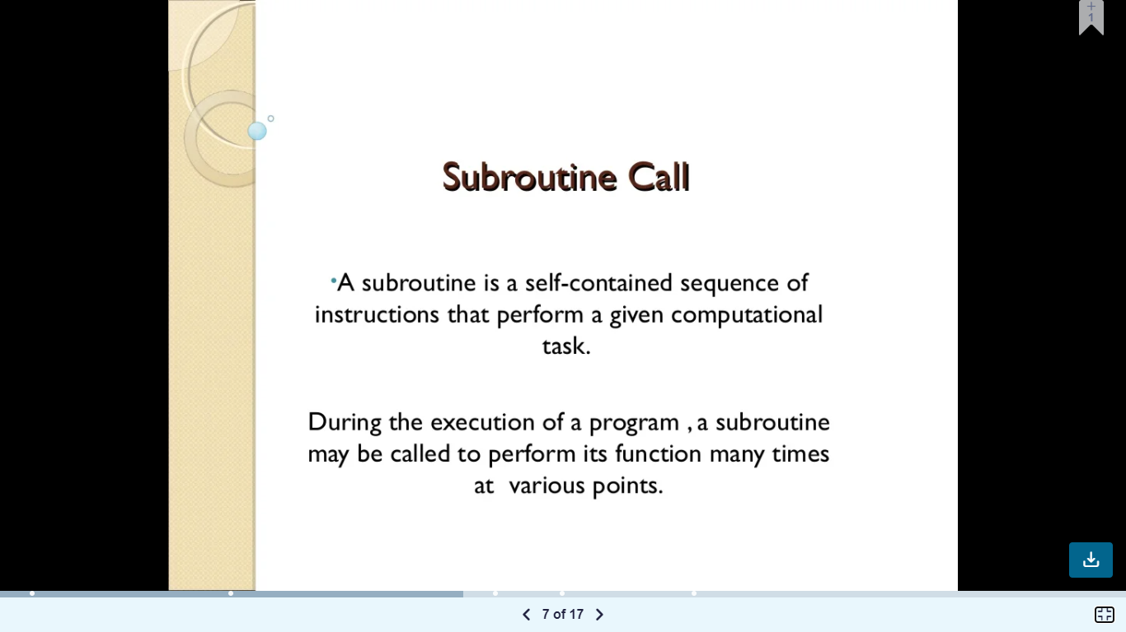

Slide 42
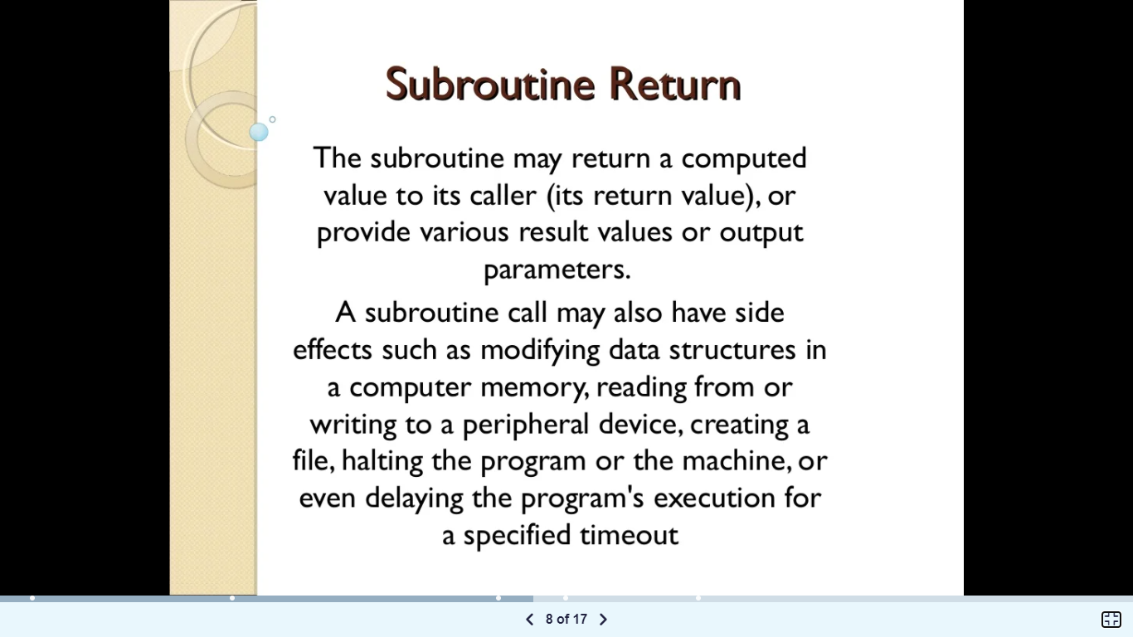

Slide 43
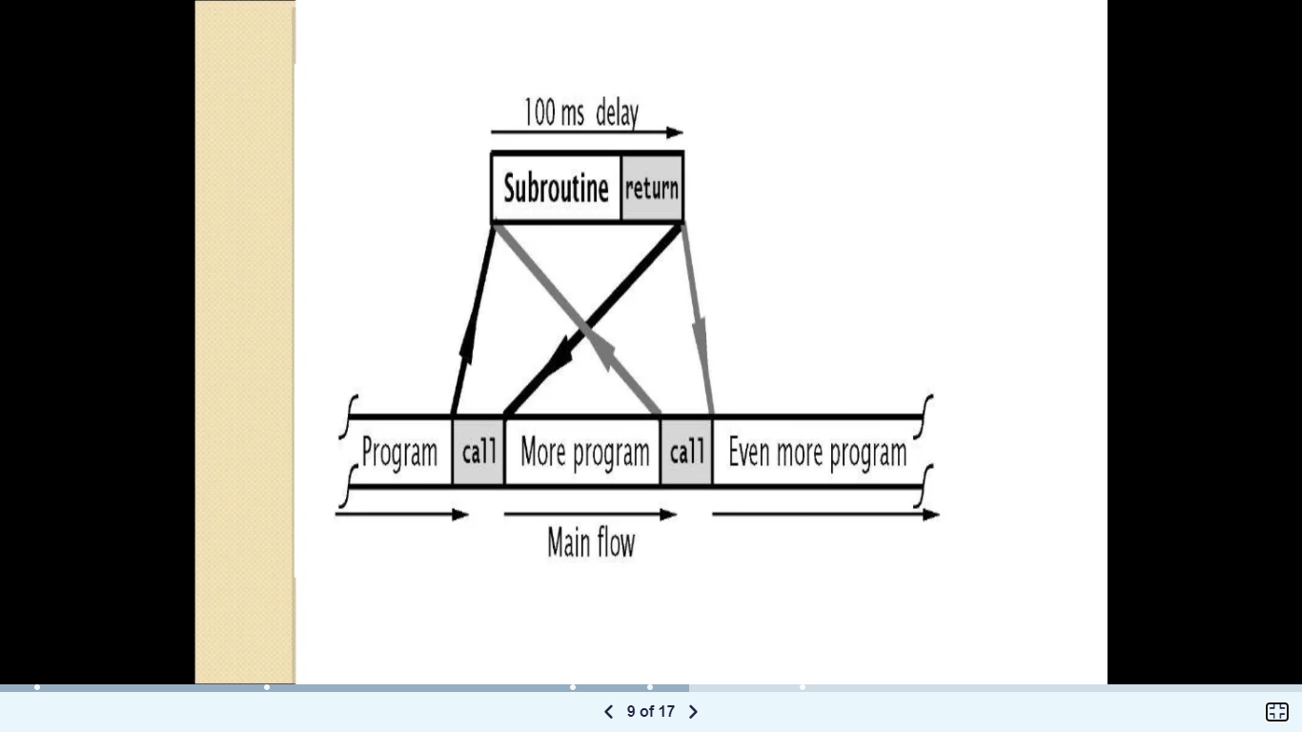

Slide 44
